Slide 1
Rumour Detection Based on Graph Convolutional Neural Net
Advanced Machine Learning in Big Data Analytics
By Achraf Halla

Slide 2
Outline
Introduction
Methadology
Expirement design
Results
Conclusion

Slide 3
Introduction - Background and Motivation
Rumor Detection in the Digital Age
Challenges: Identifying rumors in real-time due to:
Volume of Data: The vast scale of posts and interactions.
Complexity of Networks: Social media is a highly interconnected environment.
Viral Spread: Rumors can spread faster than verified information.

Slide 4
Introduction - Research Objectives
Research Objective
Goal: To propose a novel rumor detection method using a GCN-based model.
Focus: Leveraging the structure of social networks to enhance the accuracy of rumor classification.

Slide 5
Related Work - Traditional Rumor Detection Methods
1. Rule-Based Approaches
2. Machine Learning Approaches
3. Deep Learning for Rumor Detection

Slide 6
Related Work - GCN Approaches
Why GCN?
Designed to work with graph-structured data, such as social networks.
Can effectively capture local and global context in user interactions.
Suitable for tasks where relationships between nodes (posts/users) play a key role, such as rumor detection.

Slide 7
Methodology - Graph Structure for Rumor Detection
1. Source-Replies Relation Graph (SR-Graph)
Observation: In rumor conversations, replies tend to follow either the source tweet or previous replies.
SR-Graph Representation:
Nodes: Represent tweets (source or replies) in a conversation.
Node Features: Word vectors of the tweet content, weighted by the degree of the node (indicating its importance in the conversation).
Edges: Represent reply relationships between tweets.

Slide 8
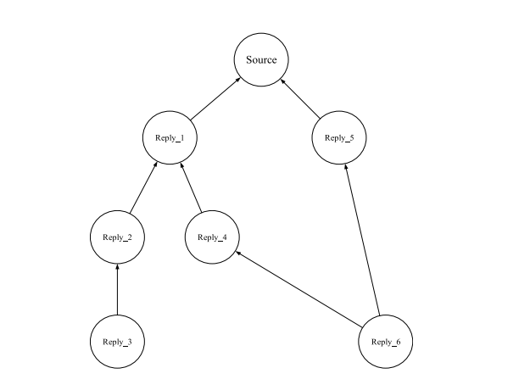
Source: Figure 1 from Bai et al., 'Rumour Detection Based on Graph Convolutional Neural Net.

Slide 9
Methodology - Ensemble Graph Convolutional Network (EGCN)
1. Ensemble GCN with Nodes Proportion Allocation Mechanism (NPAM)
EGCN Overview:
Combines a Text CNN and a Graph Convolutional Network (GCN).
Used to classify conversations (rumor vs. non-rumor) based on SR-graphs and word vectors.
The contribution of Text CNN and GCN is controlled by the Nodes Proportion Allocation Mechanism (NPAM).

Slide 10
2. Nodes Proportion Allocation Mechanism (NPAM)
N: Number of nodes in the current SR-graph.
M: Number of nodes in the maximum SR-graph.
Contribution Rate:
Feature output from the GCN is scaled by N/M.
Feature output from the Text CNN is weighted by (1 - N/M).

Slide 11
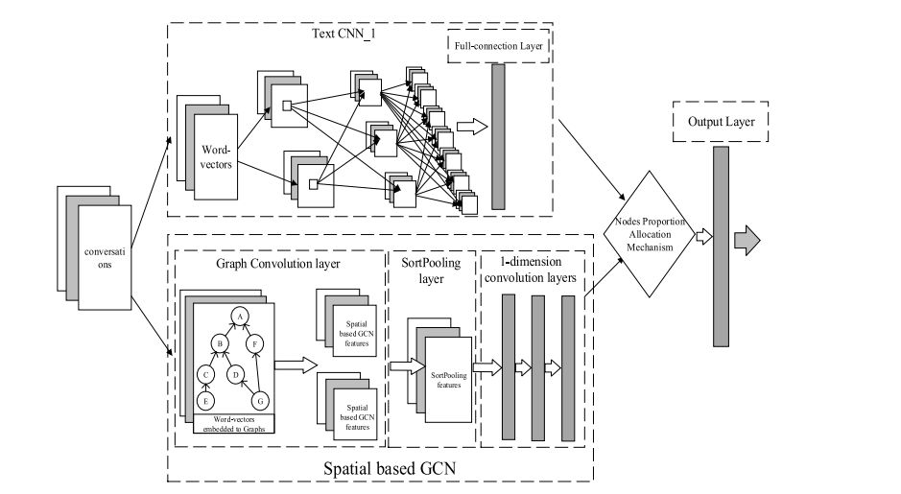
Source: Figure 2 from Bai et al., 'Rumour Detection Based on Graph Convolutional Neural Net.

Slide 12
Experiments - Datasets and Evaluation Metrics
1. Dataset: PHEME
The PHEME dataset was used, containing Twitter posts related to five significant breaking news events:
Charlie Hebdo
Ferguson Protests
Gencrash
Ottawa Shooting
Sydney Siege

Slide 13
2. Dataset Composition
Total Tweets: 5,802 annotated tweets.
Rumors: 1,972 tweets.
Non-Rumors: 3,830 tweets.
Data is organized by event, with separate directories for rumors and non-rumors, and each directory containing tweet IDs and their associated replies.

Slide 14
Evaluation Metrics
Accuracy: Measures the overall correctness of the model’s predictions.
Precision & Recall:
Precision: How many of the predicted rumors were actual rumors?
Recall: How many actual rumors were correctly identified?
F1-Score: The harmonic mean of precision and recall, balancing both metrics.

Slide 15
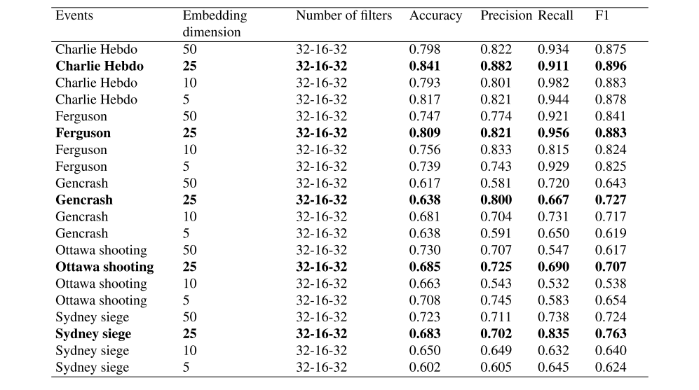
The test results of different dimensional word vectors in the dataset PHEME.
Source: Table 6 from Bai et al., 'Rumour Detection Based on Graph Convolutional Neural Net.

Slide 16
Results - Model Performance and Comparison
Source: Table 8 from Bai et al., 'Rumour Detection Based on Graph Convolutional Neural Net.

Slide 17
Conclusion
The proposed GCN-based model effectively detects rumors by leveraging both the content and network structure of social media platforms.
This approach can be further developed for real-time applications in monitoring and curbing the spread of misinformation on large-scale social platforms.
A word-embedding model designed for Twitter datasets might work better than the existing models

Slide 18
Thank you for your Attention !

